Slide 1
Pump by Priority - WAB

Slide 2
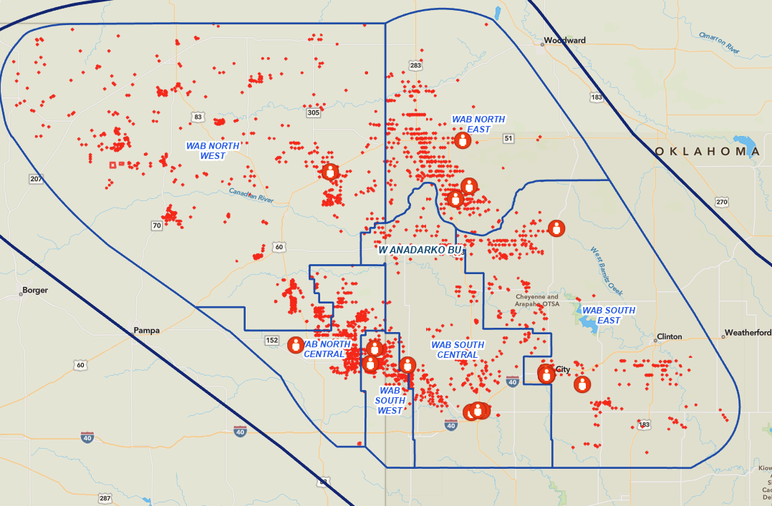
2 Levers to Optimize Margins
Route Optimization
Through Area Level Route Optimization, 8 Routes can be Eliminated
Area Consolidation
Consolidate to 2 Areas 6 Areas -> 2 Areas
Additional 5 Routes Eliminated
Target 100% Completion of Critical & High + 60% Completion of Mediums
WEST
Recommended
EAST
AREA | Flags (C/H/M) | FCF | Routes*
NE | (7,79,127) | $53MM | 7
SE | (1,16,49) | $9MM | 2
SC | (1,25,80) | $9MM | 2
EAST | (9,120,256) 385 | $71MM | 11
NW | (0,24,150) | $17MM | 3
NC | (3,21,90) | $18MM | 3
SW | (1,11,100) | $18MM | 2
WEST | (4,56,340) 400 | $53MM | 8
Average Actions per Day
Variance to Forecast | 210
Risk Visit | 107
Guage | 170
Liquid Transport | 68
Oil Haul | 14
Water Haul | 14
Oil & Water Haul | 40
Total | 555
* New recommendation assuming dynamic optimization in place

Slide 3
Labor & Vehicles Long Term Trend
Labor Optimization Actions
Eliminate “Night” LOs
Route Optimization
Reduce to 19 Dynamic Routes
Reduce Size of Specialist Pool.
LO Trained & Expected to handle 90% of issues. Escalate to Lead & Ops Center as needed
Consolidate Areas & Field Leadership / Support
Baseline
Budget
Top Quartile Benchmark
Bottoms Up Assessment

Slide 4
Proposed WAB Ops Org (Operations & Ops Center)
Foreman
Foreman
Sr. Lease Operator
Sr. Lease Operator
Lease Operator
Lease Operator
Sr. Lease Operator
Sr. Lease Operator
Lease Operator
Lease Operator
Lease Operator
Sr. Lease Operator
Sr. Lease Operator
Lease Operator
Lease Operator
Super
Operations Lead
Operations Lead
Operations Lead
Operations Lead
Sr. Lease Operator
Sr. Lease Operator
Lease Operator
Lease Operator
Lease Operator
Ops Center Manager
Operations Analyst
Ops Center Analyst
Ops Center Analyst
Ops Center Analyst
Admin
Rig Specialist
Chemical Specialist
Lease Operator
34 People
$900K / Month Target in Labor & Vehicles
585 Visits / Day
2,925 Visits / Week
30 Site Visits per Day (1/2 Day)
85 Site Visits per Day
12 People
470 Site Visits per Day
FIT Team (OOS)
2 I&E Leads
6 I&E Techs
2 Construction Leads
2 Roustabout Crews
Contract
Select top performers to form a lean and mean squad!
1.5 Days to “Churn” Field to 3.3 Days

Slide 5
BU Level Resource Allocation
There is a discrepancy between Workload, Value and Area Boundaries
Dynamic Routes have been fully tested within Area Boundaries. But results are sub-optimal field wide.
First Pass – Have multiple scenarios for each Area (+1 Resource, - 1 Resource) Provide Health Status by Area and encourage Foreman to identify opportunities to shift resources from area to area.
Second Pass – Create Dynamic Routes using Consolidated Areas
NC, SW, SC
SE, NE
NW
Final Pass – BU Level Dynamic Routes

Slide 6
Route Distribution
Previous Routes are based on # wells and drive time. Did not factor Cash Flow / Liquid Production
Anticipated activity was not factored in, including
Lift Equipment Troubleshooting
Gauging Frequency
Update Routes based on Cash Flow and Activity
Leverage Data to Decrease Routes from 33 to 19
Average Cash Flow per LO increases from

Slide 7
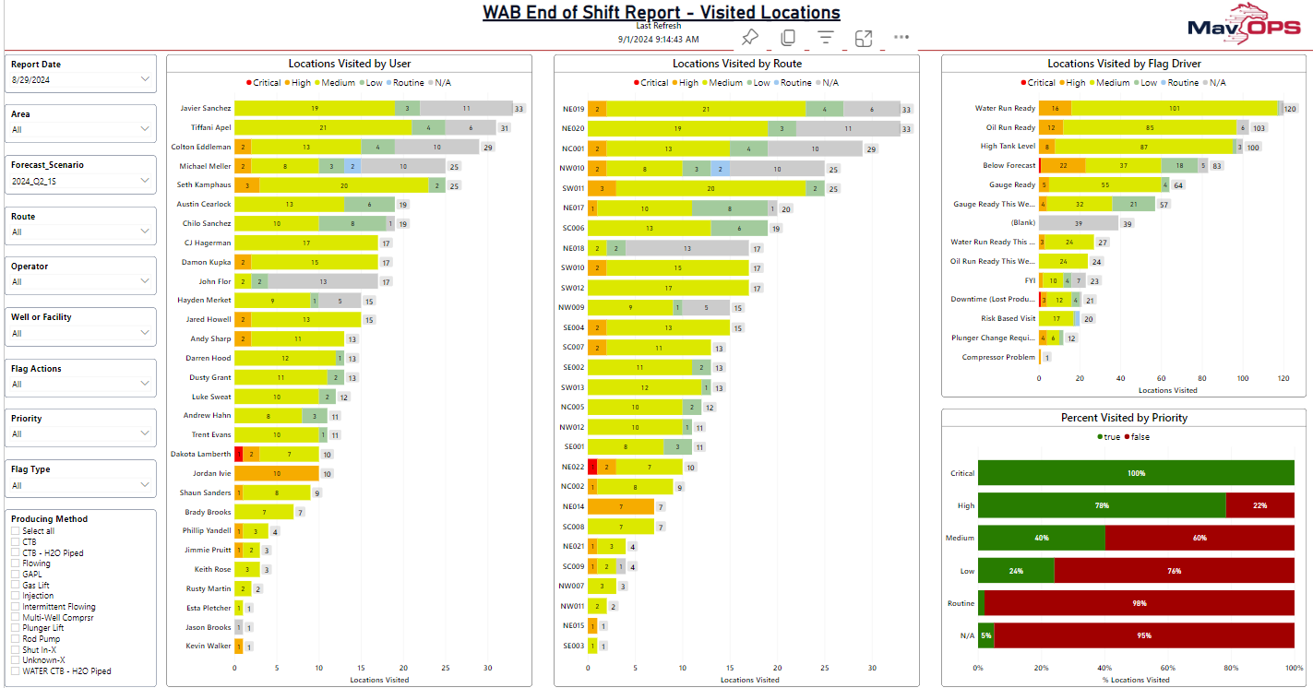
08/29 – Dialed in Flags

Slide 8
Maverick Advanced Technologies Implementation Council (MATIC)

Slide 9

MATIC Guiding Principles
Adopt field first philosophy
Successful change requires executive sponsorship
Educate the field & office to ensure they have the same understanding
The best way to gain trust is to demonstrate value
Spend time and effort in hands-on training to improve adoption

Slide 10

Maverick Operational Priority System (MAV OPS)
Less than 20 minutes per day doing data entry
85%+ Productive time
LOs area assigned high value tasks
End of Shift Report is automatically compiled for the field management team! No more digging in outlook, notebooks or texts to explain past production variances!
Seamless field communication historized in the data lake
Day to Day note taking is seamlessly integrated with back-office systems!
Resources Allocated to Top Issues (Field Wide)

Slide 11










KPIs to Measure PbP Success
35% of Day
85%+
Key Sources of Waste
Data Analysis
Data Entry
Opportunity Cost (going to low priority sites)
Wasted Travel
Not able to fix the issue
Re-routed mid flight
Collecting Unnecessary Information
Failing to fix / inspect things while on site
Capable people who are qualified to address issues are quickly dispatched. Their truck is loaded with the right tools and materials, they understand what is expected for the day at 6 AM. They are re-routed only if something critical comes up, which is communicated to them in an efficient manner.
Leading indicators of success
% Productive Time (Time working at Field Sites / Total Time)
Impact per Visit ($ Prod Returned + $ Inventory Sold / # visits)
Field Office vs. Productive Worker (Office Support LOE / Field Support LOE) (HRS within Office / HRS at Routes Stops)
Ultimately, Cash flow is the measure of success.
Beginning of Shift Analysis
Travel
Inspect
Fix
End of Shift Data Entry
15% of Day
20% of Day
0%
5%
Waiting on Approval
Collecting Unnecessary Information
20 minutes or less of data entry
Wasted Miles
30% of Day
Fail to Fix
Poor Inspection
<10%
7+ Productive Hours per day (8hr shift)

Slide 12
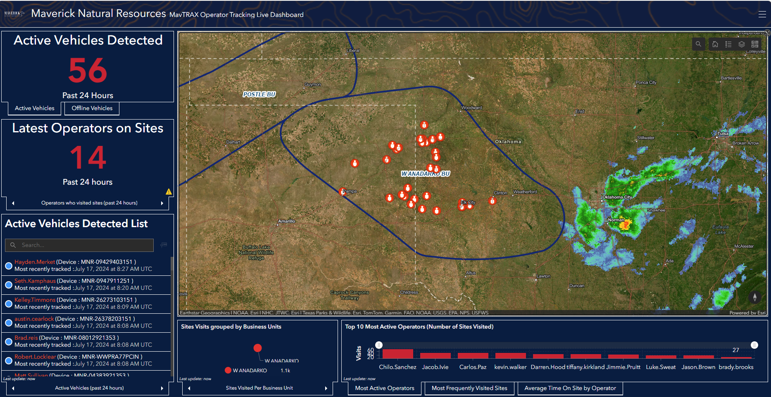
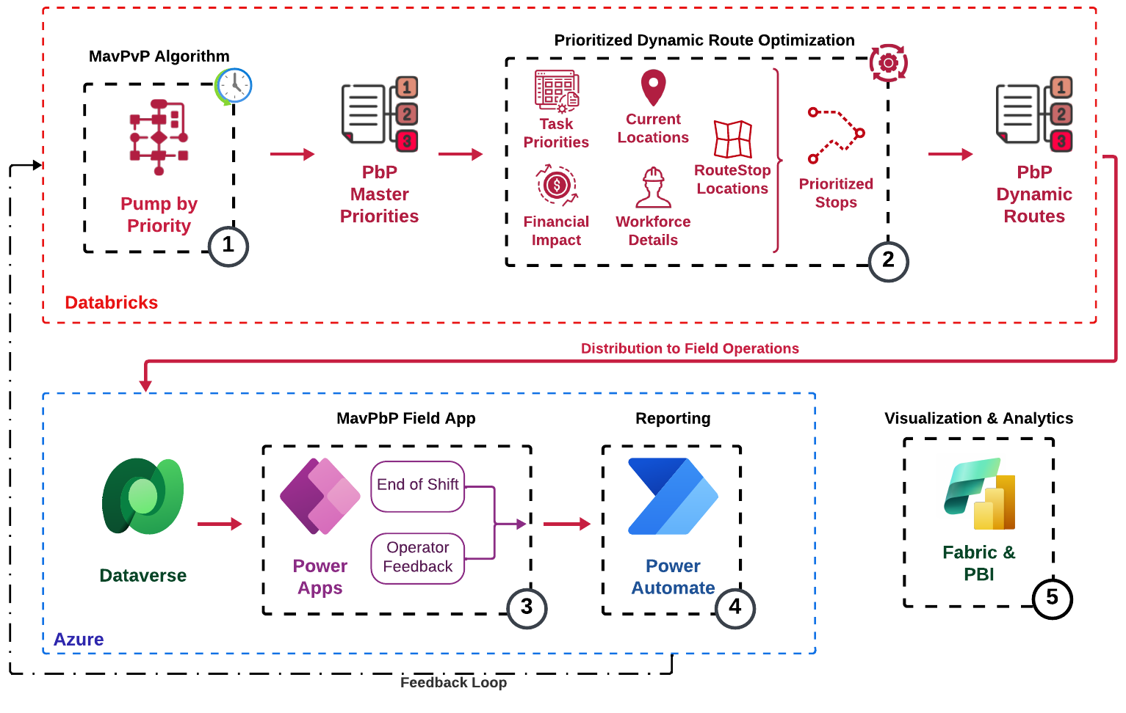
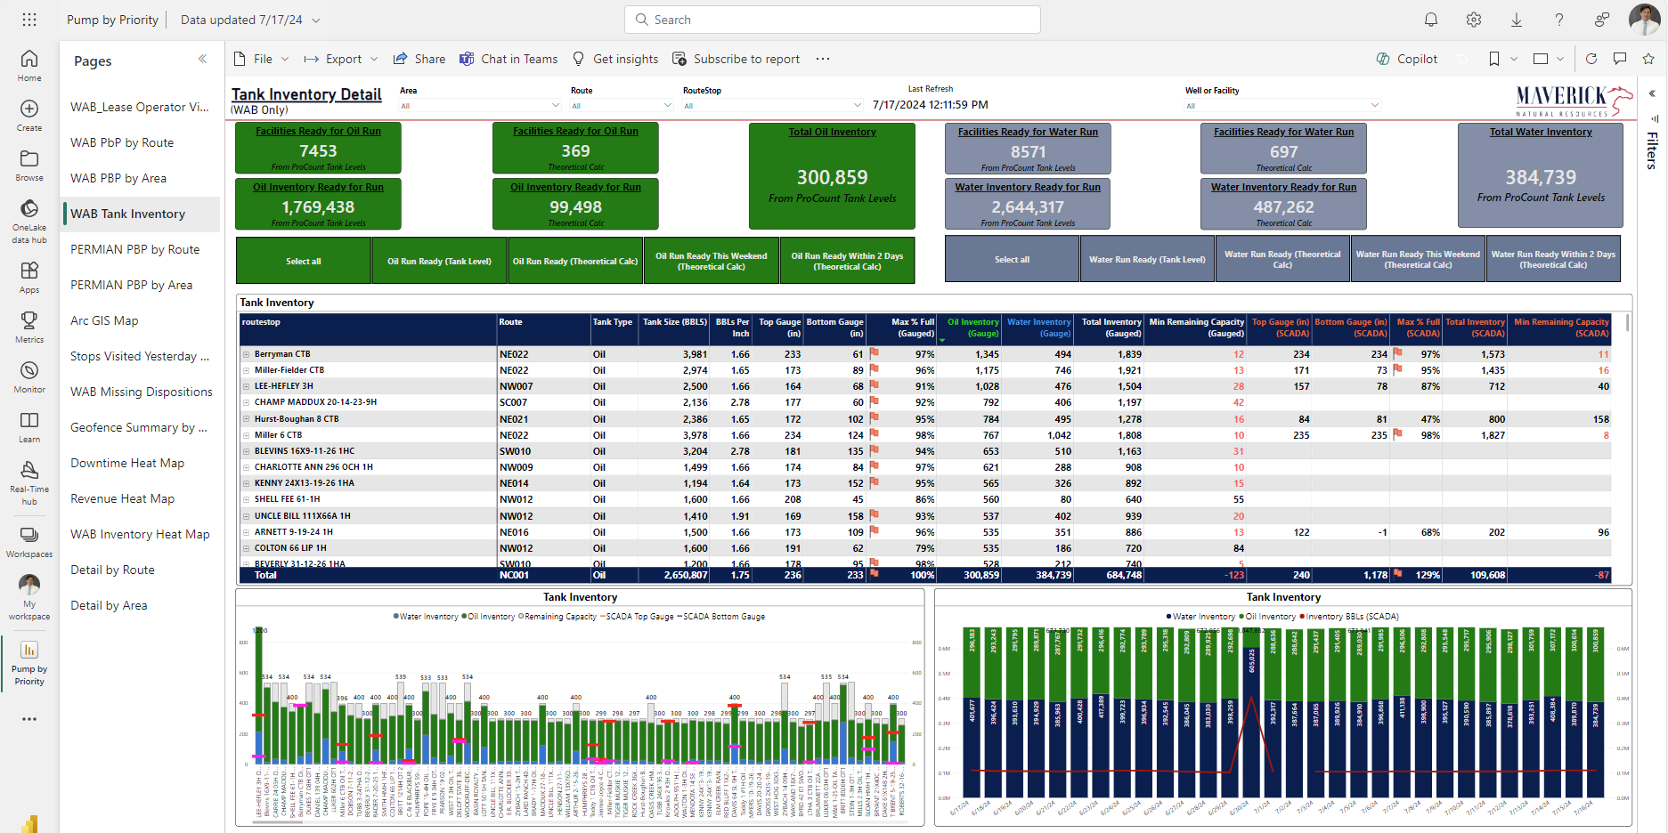
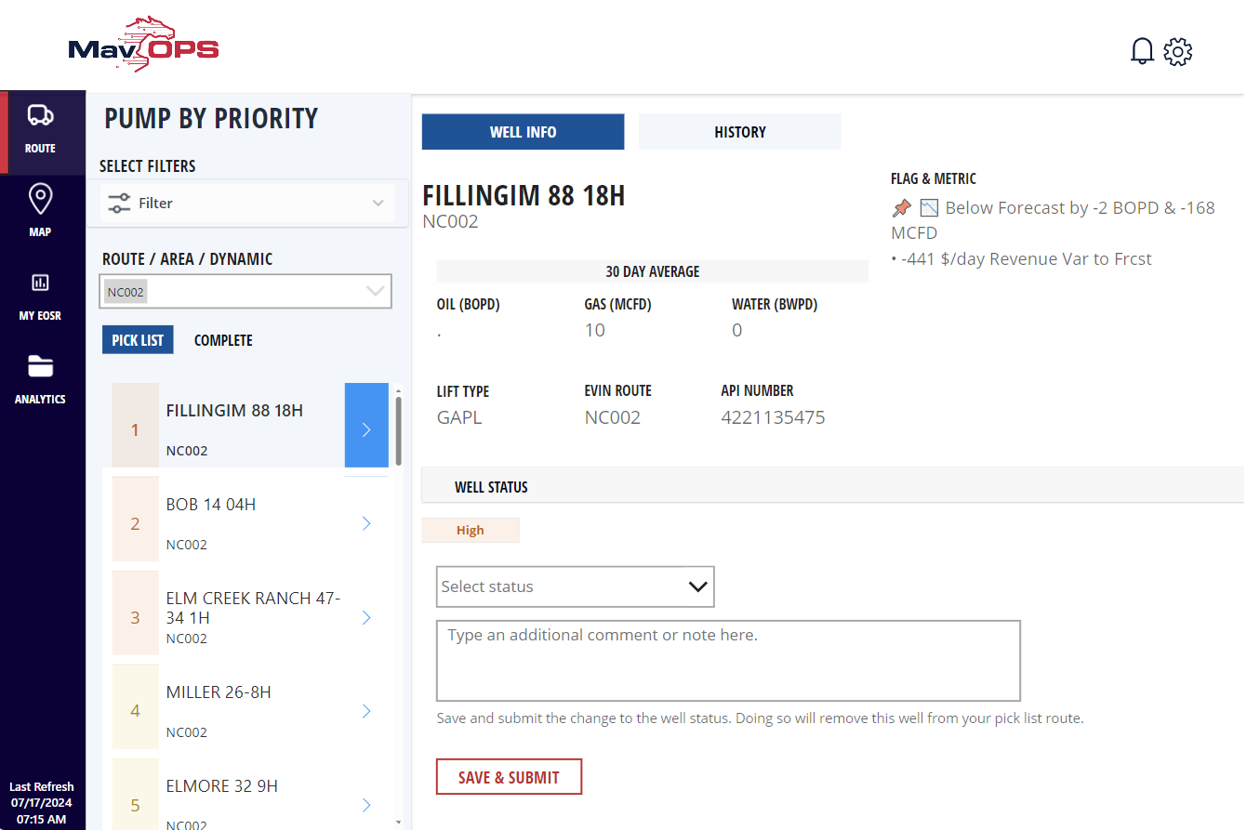
Tools & Capabilities
Empowering Efficiency: Technical Architecture
MAVTRAX Dashboard
Developed to Validate Data Flow and showcase ESRI capabilities.
Best Use Case is Tracking Personnel during severe weather events
Access Granted by Rick & Jerod Fields (Can see ALL personnel)
Consolidated ERP datasets result in improved feedback and reduced data silos. The increased production is realized by responding to real-time data analytics of a comprehensive data driven digital-twin. Our cutting-edge prioritization algorithm dynamically adapts to changing conditions, ensuring resources are optimally allocated, while automation capabilities streamline workflows, reducing manual intervention and enhancing operational agility.
MavOPS PowerBI Dashboard
Set of Dashboards that allows analysts and management personnel to take a deep dive into the MavOPS data.
MavOPS Power App
User Interface for Field Personnel (currently focused on WAB Lease Operators). Presents information in an easy to digest way and facilitates communication between LOs, their management and the Ops Center.
The win is realized by improving data delivery speed; enabling qualified operators to do meaningful work quickly.

Slide 13
Pump by Priority Flags
Cash Flow – Layer 1
Risk & Visit – Layer 2
📉 Below Forecast
Routine to Critical - based on Revenue/day Variance to Aries Live
$50 - $100 (Routine) ꟷ $100 - $200 (Low) ꟷ $200 - $300 (Medium)
$300 - $750 (High) ꟷ > $750 (Critical)
🛠️ Downtime (Lost Production)
Routine to Critical - based on Revenue/day Variance to Aries Live
$50 - $100 (Routine) ꟷ $100 - $200 (Low) ꟷ $200 - $300 (Medium)
$300 - $750 (High) ꟷ > $750 (Critical)
🚨 MCFD SCADA Variance to Yesterday
Routine to Critical - based on SCADA Gas Revenue/day Variance to Yest.
Must be greater than $50 in revenue variance and over 50% diff in MCFD
$50 - $100 (Routine) ꟷ $100 - $200 (Low) ꟷ $200 - $300 (Medium)
$300 - $750 (High) ꟷ > $750 (Critical)
🚚 Oil or Water Run Ready
Medium to High
Escalates to High when:
Avg Runs per day over last 180 days >= 0.5
🚚 Oil or Water Run Ready this Weekend
Medium to High
Medium on Thursday
High on Friday
⚠️ Tank Over 90% Full
Medium
👷 Gauge Ready
Low to Medium - based on days since 50% or 75% of load ready
0 days (Low) ꟷ 1 or more days overdue (Medium)
📅 Gauge Ready on Weekend
Low: Thursday (50% Gauge)
Medium: Thursday (75% Gauge) or Friday (50% Gauge)
High: Friday (75% Gauge)
👓 Recent Workover, Visual Inspection Needed
Medium (first 3 days post workover)
⚙️ Repeat Failure Well
Routine to Medium based on days since last visit
0-6 days (Routine) ꟷ 7-13 days (Low) ꟷ >=14 day (Medium)
👷👓 Risk Based Visit Required
Routine to High - based on days since last visit & Risk Matrix
FYI Flags – No Scoring
📌 Primary Priority Score Flag/s
🛠️ Subsurface/Downhole Failure
🐿️ Invalid Downtime Code (From SCADA)
🧭 Tubing Pressure Variance Exceeds 75% and is >= +/- 25 psi
🧭 Casing Pressure Variance Exceeds 75% and is >= +/- 25 psi
🧭 Flowline Pressure Variance Exceeds 75%
📋 Missing Disposition
📈 Above Forecast

Slide 14
Risk Matrix Visit Days
Score | Fluid Rate (BFPD) | Gas Rate (MCFD)
6 | >=150 | >=5000
5 | 75-150 | 2000-5000
4 | 25-75 | 500-2000
3 | 5-25 | 250-500
2 | 1-5 | 50-250
1 | <1 | <50
Visit Frequency
 |  | Production Risk
 |  | 1 | 2 | 3 | 4 | 5 | 6
Distance Risk | 4 | 7 days | 3 days | 3 days | 1 day | 1 day | 1 day
 | 3 | 14 days | 7 days | 3 days | 3 days | 1 day | 1 day
 | 2 | 21 days | 14 days | 7 days | 3 days | 3 days | 1 day
 | 1 | 28 days | 21 days | 14 days | 7 days | 3 days | 3 days
Score | Distance from Population (ft) | Distance from Water (ft)
4 | <=900 | <=300
3 | 900-2400 | 300-750
2 | 2400-4500 | 750-1500
1 | >4500 | >1500

